Slide 1
XG Boosting/GradientBoostingRegressor
Gradient boosting regression trees are based on the idea of an ensemble method derived from a decision tree. The decision tree uses a tree structure. Starting from tree root, branching according to the conditions and heading toward the leaves, the goal leaf is the prediction result
XGBoost, which stands for Extreme Gradient Boosting, is a scalable, distributed gradient-boosted decision tree (GBDT) machine learning library. It provides parallel tree boosting.

Slide 2
Use of XGBoost regressor
One of the key advantages of XGBoost is its ability to handle missing data and large datasets efficiently. It also has a number of hyperparameters that can be tuned to improve model performance, including the learning rate, depth of the trees, and regularization parameters.

Slide 3
XGBoost vs gradient boosting
XGBoost builds upon the principles of traditional gradient boosting while introducing several enhancements and optimizations that make it a go-to choice for predictive modeling tasks. XGBoost is designed for efficiency and scalability, making it significantly faster than traditional gradient boosting implementations.

Slide 4
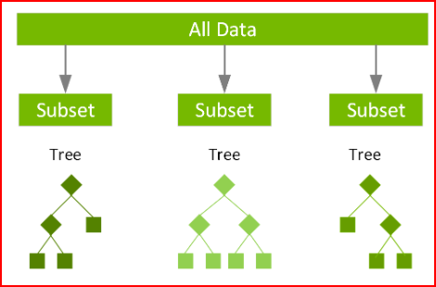
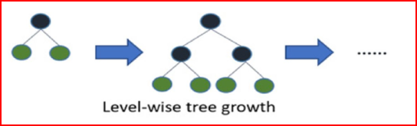
XG boosting - high accuracy and computational speed

Slide 5
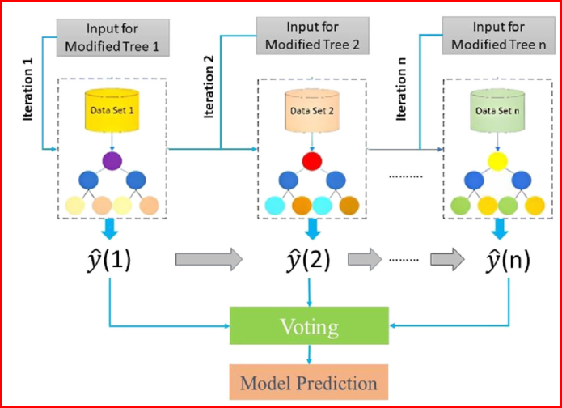
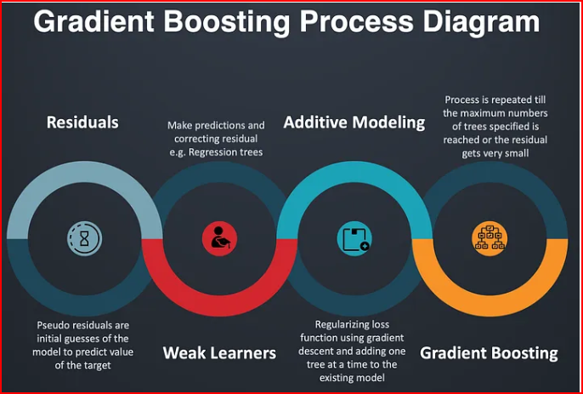
XGboost
GradientBoostingRegressor

